Slide 1
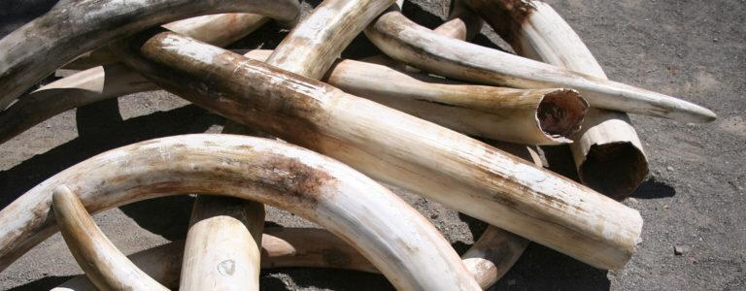
POACHING- A THREAT TO BIODIVERSITY
GROUP 7 (TOPIC 12)

Slide 2
OUTLINE
Introduction
Reasons for poaching
Evidence and examples of poaching
Effects of poaching on biodiversity
Ways to curb poaching
Conclusion
References

Slide 3
INTRODUCTION
Poaching refers to the illegal and unauthorized exploitation of wildlife for various purposes such as the wildlife trade or trophy hunting.
Forms of poaching
Timber poaching
Marine wildlife poaching
Trophy hunting
Ivory poaching
Pet trade poaching
TIMBER POACHING

Slide 4
MARINE POACHING
TROPHY HUNTING

Slide 6
REASONS FOR POACHING CONT’D
Traditional practices and cultural beliefs
Economic gain
Demand for exotic pets and live animals
Trophy hunting and illegal hunting
Poverty and lack of livelihood

Slide 7
EVIDENCE OF POACHING
Animal remains
Illegal traps and snares
Gunshot or arrow wounds
Tracks and footprint
Testimonies or tips

Slide 8
EXAMPLES OF POACHING
Elephant Poaching in Africa:
According to the Great Elephant Census (2016), it was estimated that approximately 144,000 elephants were lost from 2007 to 2014 due to poaching. In 2020, a major poaching incident occurred in Botswana's Okavango Delta, where over 350 elephant carcasses were discovered, all victims of poaching.

Slide 9
EXAMPLES OF POACHING CONT’D
Tiger Poaching in Asia:
Tigers have been relentlessly targeted by poachers for their body parts, particularly in countries like India, China, and Southeast Asian nations. In 2018, a major tiger poaching incident shocked the world when authorities seized 100 tiger carcasses in a temple in Thailand.

Slide 10
EXAMPLES OF POACHING CONT’D
Timber Poaching:
Illegal logging and timber poaching contribute to deforestation and habitat destruction. It occurs in various regions worldwide, such as the Amazon rainforest, the Congo Basin, and Southeast Asia. In 2020, a major timber poaching case in Brazil led to the dismantling of a criminal network involved in illegal logging in the Amazon. The operation resulted in the seizure of thousands of cubic meters of illegally harvested timber.

Slide 11
EFFECTS OF POACHING ON BIODIVERSITY
Disruption of food chain
Habitat destruction
Decline of endangered species
Economic impact

Slide 12
WAYS TO CURB POACHING
Strengthen legislation and law enforcement
Public awareness
International cooperation and collaboration
Conservation and protected areas
Technology and innovation

Slide 13
CONCLUSION
Poaching poses a severe threat to biodiversity, pushing countless species towards extinction and disrupting ecosystems but with our individual actions and international cooperation we can make a difference.

Slide 14
REFERENCES
Great Elephant Census: You can find information and reports on elephant populations and poaching at the official website: https://www.greatelephantcensus.com/
Rhino poaching in South AfricaThe South African Department of Environmental Affairs provides updates and reports on rhino poaching: https://www.environment.gov.za/
Tiger poaching in Asia: The World Wildlife Fund (WWF) has information on tiger conservation and the illegal wildlife trade: https://www.worldwildlife.org/
Pangolin poaching: The IUCN provides resources on pangolin conservation and the illegal trade: https://www.iucn.org/
Timber poaching: Global Forest Watch offers data and reports on deforestation and illegal logging worldwide: https://www.globalforestwatch.o
World Wildlife Fund (WWF): Their website provides valuable information and publications on wildlife conservation and the illegal wildlife trade. - Website: https://www.worldwildlife.org/
International Union for Conservation of Nature (IUCN): The IUCN publishes reports and articles on various conservation issues, including poaching and its impact on biodiversity. - Website: https://www.iucn.org/
Convention on International Trade in Endangered Species of Wild Fauna and Flora (CITES): CITES provides reports and documents related to the regulation of international trade in endangered species, including information on poaching. - Website: https://www.cites.org/

Slide 15
